Slide 1
EagleSat 2 – Electrical Power Subsystem Development
Presented by: Chloe McClellan – Electrical Power Lead
In cooperation with: Dr. Gary Yale, Hilliard Paige, Jason Hamburger, Steven Buck, David Stockhouse, and Lauren Barthenheier
27th Arizona Space Grant Symposium
Tempe, Arizona
April 14nd 2018

Slide 2
Outline
Background Information
  Mission Considerations
Power Budget
  Subsystem Power Consumptions
  Power Budget Visual
Hardware
  Solar Panels
  EPS Board
  Battery
Conclusions
  Testing
  Summary

Slide 3
Background Information

Slide 4
Mission Considerations
Objective – to provide electrical power to bus and payload subsystems
Design Factors – spacecraft size, solar cell surface area, robustness of hardware, orbit path

Slide 5
Power Budget

Slide 6
Subsystem Power Consumptions
SUBSYSTEM | PEAK POWER CONSUMPTION (W) | TYPICAL POWER CONSUMPTION (W)
Communications | 2.7 | 0.1
On Board Computer | 0.9 | 0.5
Cosmic Ray Payload | 1.8 | 0.4
Memory Degradation Payload | 0.2 | 0.2
Attitude Determination and Control | 1.2 | 0.7
Structure | 0 | 0
Electrical Power | 0.3 | 0.3
Total | 7.1 | 2.2
Notes:
Double check values with team leads

Slide 7
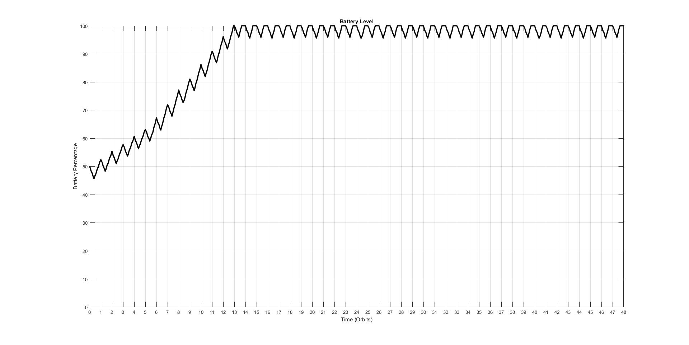
Power Budget
Notes:
Worst case scenario
Start in eclipse

Slide 8
Hardware

Slide 9
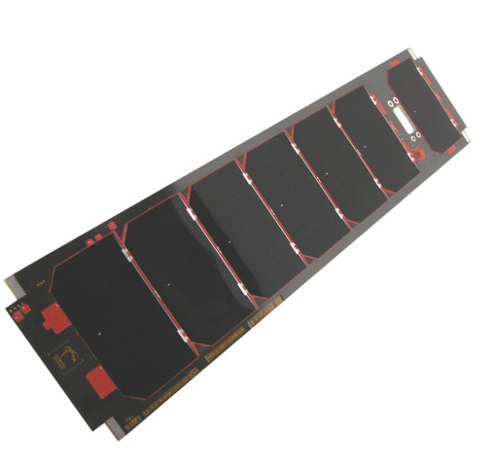
Solar Panels
3U solar panels by Clydespace
7 Watt generation (BOL)
Configuration: Two custom, two original
  Custom panels will have once cell removed
  Alternating custom and original on long faces

Slide 10
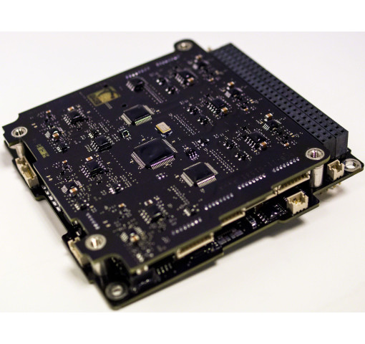
EPS Board
Clydespace 3rd Gen FlexU
Designed to support high power spacecraft
< 90% effieiency
Higher number of battery charge
regulators and other safety features

Slide 11
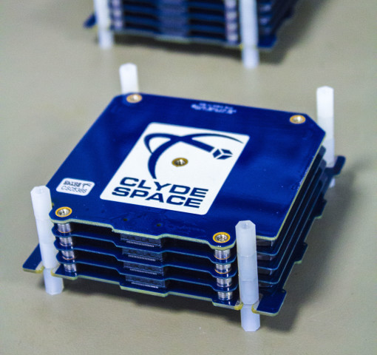
Battery
Clydespace 40 Whr Battery
Capacity great enough to continue operations while in eclipse
Lithium Polymer battery in 2s4p configuration
Complies with NASA EP-Wi-032
Multiple protection features

Slide 12
Conclusions

Slide 13
Testing
High Altitude Balloon
  Ensure payloads are functional
Clyde-Space Validation
  Ensure battery is safe for manned missions

Slide 14
Summary
Battery reaches full capacity within 16 orbits under worst-case scenario conditions
Depth of discharge is less than 10% after reaching full capacity
Power budget is robust enough to accommodate greater than typical consumption without damaging components

Slide 15
Acknowledgements
Dr. Gary Yale, Embry-Riddle Aeronautical University
Travis Imken, Jet Propulsion Laboratory
Dr. Julio Benavides, Embry-Riddle Aeronautical University

